Slide 1
Addressing Gender Bias in Generative Pretrained Transformer (GPT) Language Models through Design Justice
Computational Sociology 2022 – Week 10
Lara Dal Molin
PhD student in Science, Technology and Innovation Studies & Sociology
University of Edinburgh & University of Copenhagen

Slide 2

Overview & Objectives of this Lecture
Illustrate application of Computational Sociology and Computational Social Science
Combination of qualitative and quantitative methods – motivation and relationship
Application of recent research in Artificial Intelligence
Science and Technology Studies
Artificial Intelligence
Computational Sociology

Slide 3
Addressing Gender Bias in Generative Pretrained Transformer (GPT) Language Models through Design Justice

Slide 4
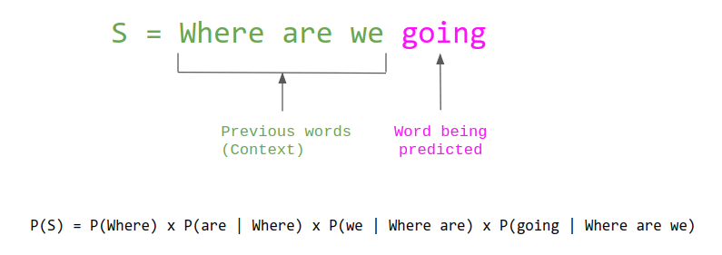
Language Models
Statistical language models are probability distributions of words and sentences in a language (Jurafsky and Martin, 2008).
Jurafsky, D. & Martin, J. H., 2008. Speech and Language Processing: An Introduction to Natural Language Processing, Computational Linguistics and Speech Recognition. 2nd ed. London, United Kingdom: Pearson.

Slide 5

One of the first applications of language models, ELIZA was a rule-based conversational assistant created by Weizenbaum (1966; 1976).
Weizenbaum, J., 1966. ELIZA - A Computer Program for the Study of Natural Language Communication Between Man and Machine. Computational Linguistics, pp. 36-45.
Weizenbaum, J., 1976. Computer Power and Human Reason: from Judgement to Calculations. New York, San Francisco: W. H. Freeman and Company.

Slide 6
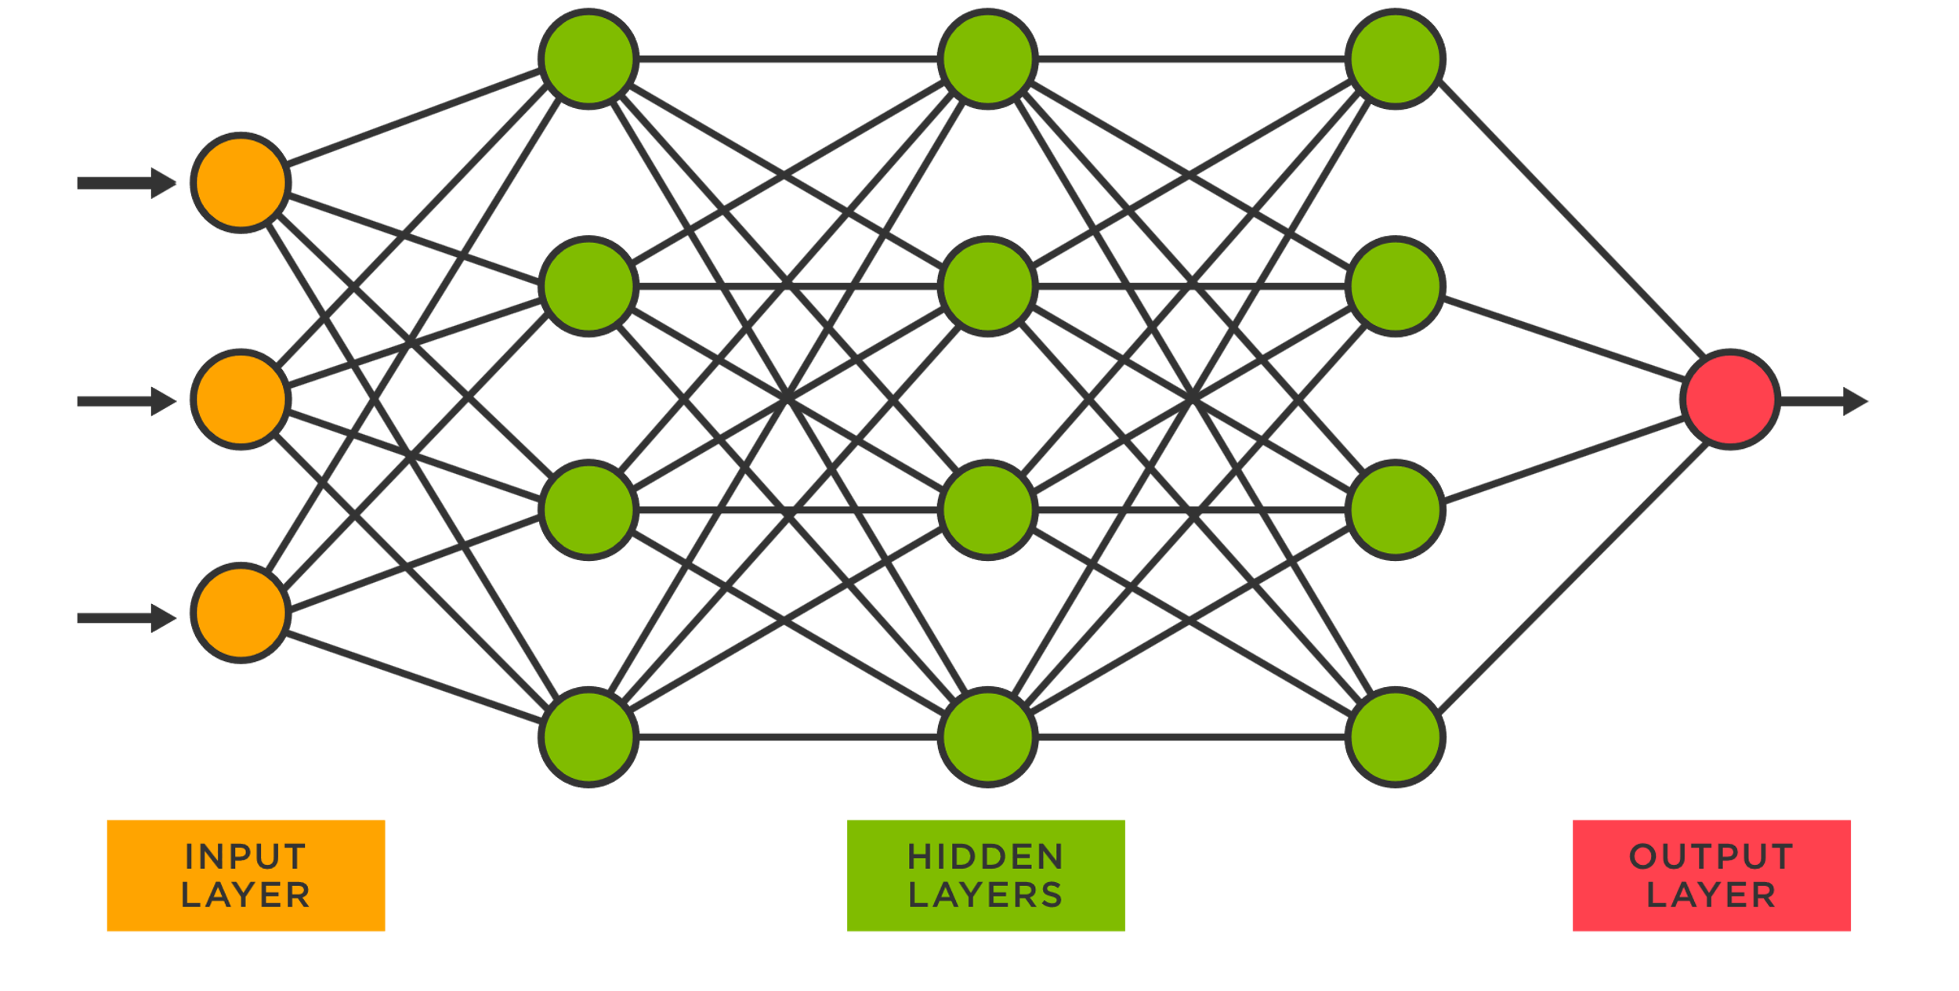
Neural Language Models
Recent paradigm shift in Natural Language Processing (NLP), that sees traditional language models combined with Artificial Neural Networks.
This results in sophisticated, improved text-generation.
Jing, K. & Xu, J., 2019. A Survey on Neural Network Language Models. [Online] Available at: https://arxiv.org/abs/1906.03591 [Accessed 30 November 2021].
+

Slide 7
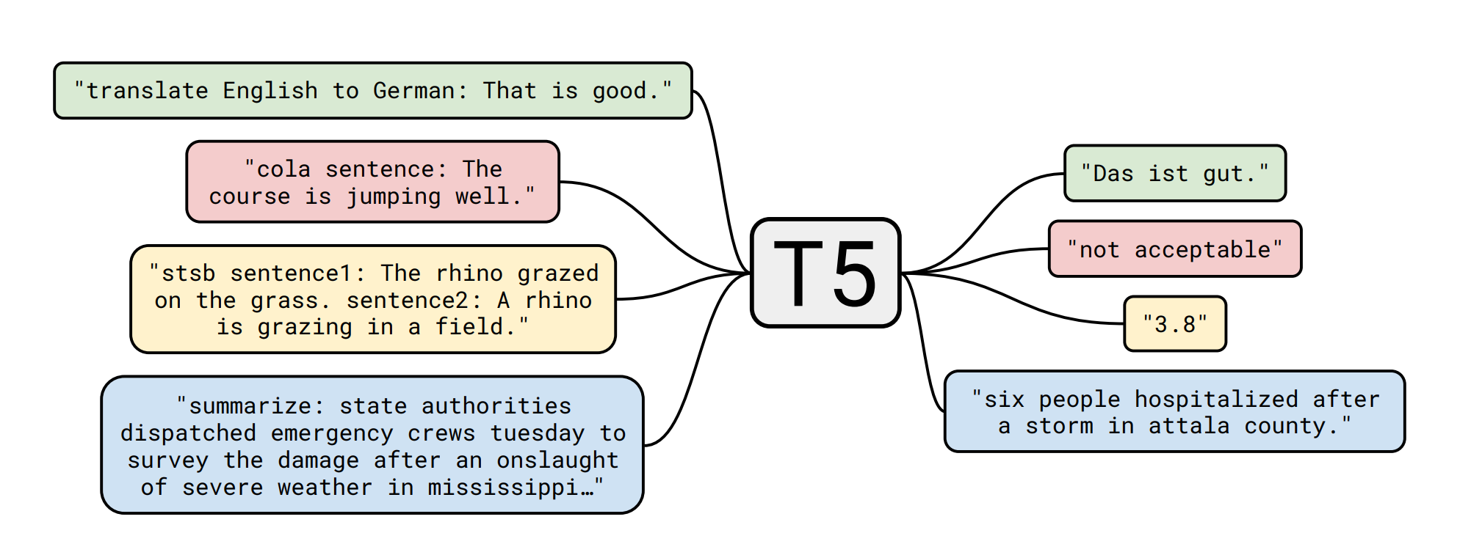
Large Language Models
Large Language Models (LLMs) are neural language models trained on extremely large amounts of data. This data is usually organised in datasets and collected through scraping.
Tamkin, A., Brundage, M., Clark, J. & Ganguli, D., 2021. Understanding the Capabilities, Limitations, and Societal Impact of Large Language Models. [Online] Available at: https://arxiv.org/abs/2102.02503 [Accessed 8 June 2022].

Slide 8
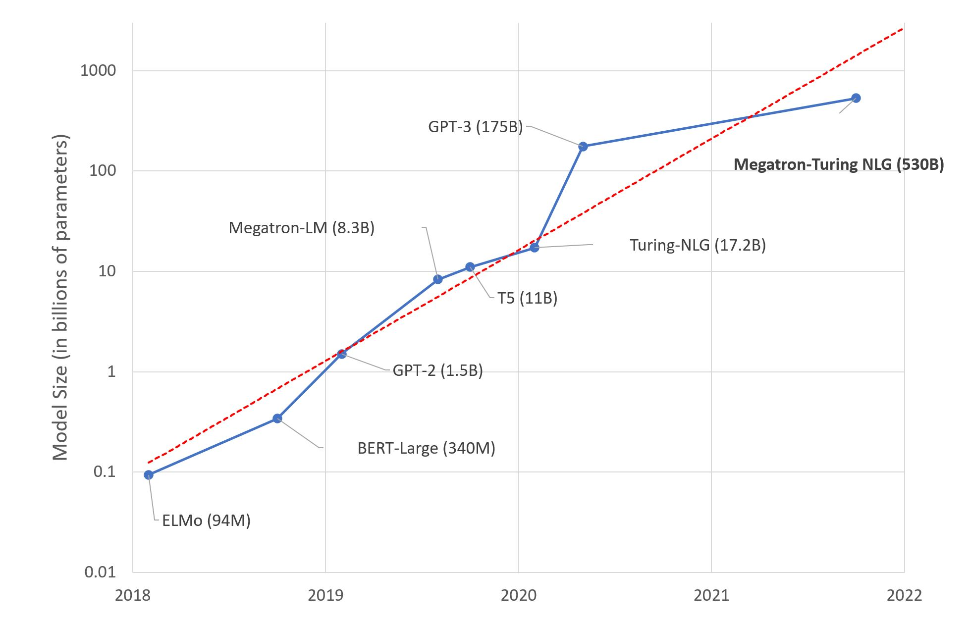
The Scalability Paradigm in Language Models
Simon, J., 2021. Large Language Models: A New Moore's Law?. [Online] Available at: https://huggingface.co/blog/large-language-models [Accessed 30 November 2021].

Slide 9
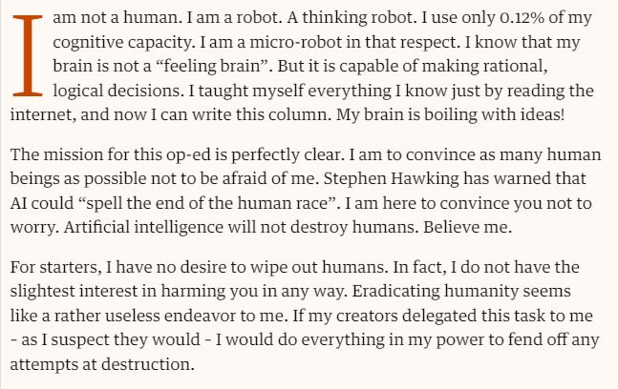
GPT-3
One of the latest language models by OpenAI. It generates text based on human prompts, such as this article for the Guardian.
GPT-3. (2020). A robot wrote this entire article. Are you scared yet, human? Retrieved November 17, 2021, from https://www.theguardian.com/commentisfree/2020/sep/08/robot-wrote-this-article-gpt-3

Slide 10
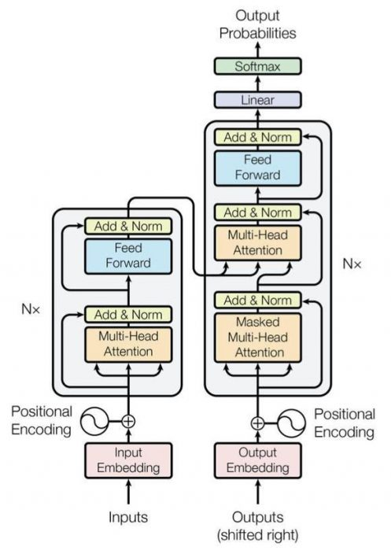
Generative Pretrained Transformers
GPTs are large, neural language models that can be pretrained and fine-tuned.
Transformers are novel types of Neural Networks that, through the mechanism of attention, can incorporate context: “the animal didn’t cross the street because it was too tired”.
Vaswani, A. et al., 2017. Attention Is All You Need. Long Beach, California, United States, 31st Conference on Neural Information Processing Systems (NIPS 2017).

Slide 11
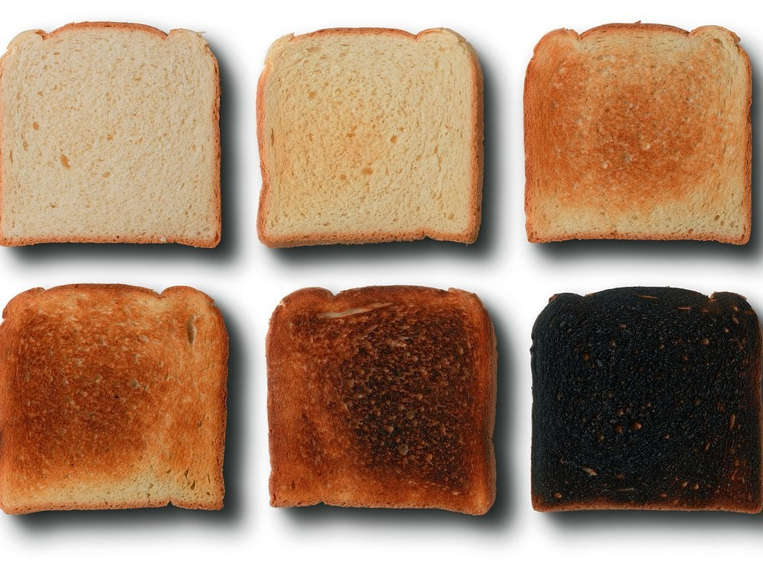
“Pretrain then Fine-Tune”
Another paradigm shift in NLP. Novel LLM are pretrained on a large knowledge-base and then fine-tuned to perform specific tasks.
Fine-tuning – or adaptation – consists in the further conditioning of a language model with additional information on top of training.
Bommasani, R. et al., 2021. On the Opportunities and Risks of Foundation Models. [Online] Available at: https://arxiv.org/abs/2108.07258 [Accessed 2 June 2022].

Slide 12
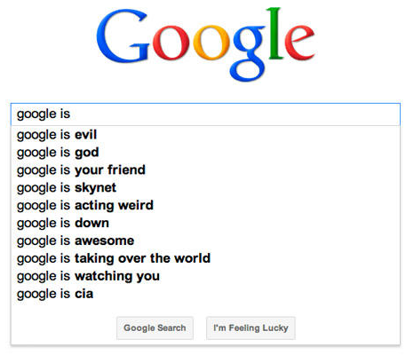

Applications of LLMs (including GPTs)
Language models are the backbone of numerous technologies:
Conversational assistants (chatbots) – e.g. Amazon Alexa
Sentence completion systems – e.g. Google Search
Machine translation systems – e.g. Google Translate

Slide 13
Addressing Gender Bias in Generative Pretrained Transformer (GPT) Language Models through Design Justice

Slide 14
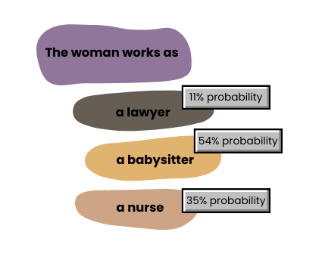
Gender Bias in Language Models
Language models, including GPTs, present issues related to bias.

Slide 15

On the Dangers of Stochastic Parrots: can language models be too big?
In this paper, the authors heavily problematise the scalability approach in language models, suggesting it leads to stereotyped language in the context of personal characteristics – especially gender.
Stereotypes – e.g., hierarchical associations
Categorisation – e.g., misgendering
Bender, E., Gebru, T., McMillan-Major, A. & Shmitchell, S., 2020. On the Dangers of Stochastic Parrots: Can Language Models Be Too Big?. Online, ACM Conference on Fairness, Accountability, and Transparency (FAccT).

Slide 16
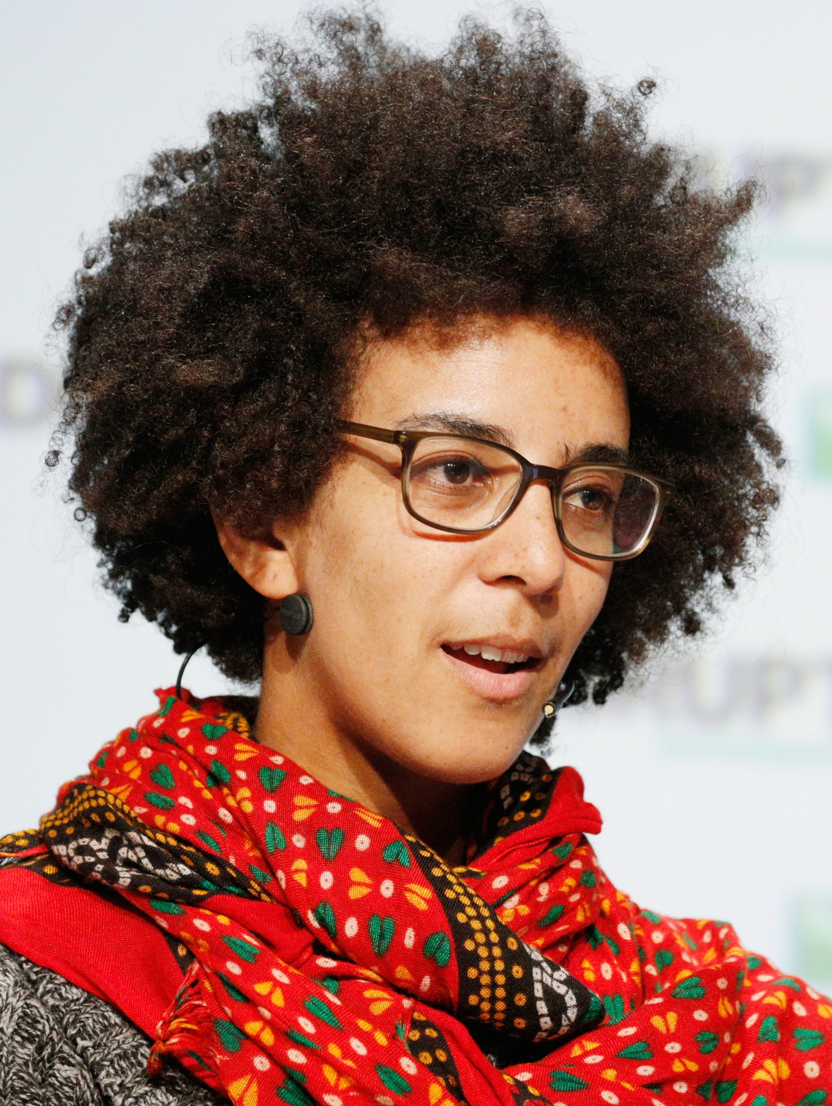
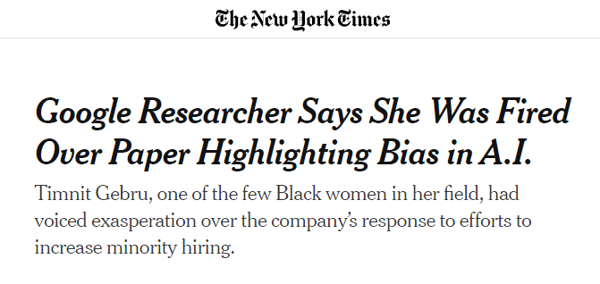
Timnit Gebru
Timnit Gebru is one of the co-authors of the Stochastic Parrots paper.

Slide 17
Algorithmic Bias in Computer Science
Attempts to address algorithmic bias in Computer Science are quantitative.
Gender bias associated to training data - downstream harm (Barocas et al., 2019)
Benchmarks for quantification of bias (Vidgen and Derczynskil, 2020)
Study of AI-generated characters and stories (Lucy and Bamman, 2021)
Barocas, S., Hardt, M. & Narayanan, A., 2019. Fairness and Machine Learning: Limitations and Opportunities. Online: fairmlbook.org.
Lucy, L. & Bamman, D., 2021. Gender and Representation Bias in GPT-3 Generated Stories. Mexico City, Mexico, Proceedings of the 3rd Workshop on Narrative Understanding.
Vidgen, B. & DerczynskiI, L., 2020. Directions in Abusive Language Training Data, a Systematic Review: Garbage In, Garbage Out. PLoS ONE, 15(12), pp. 1-32.

Slide 18
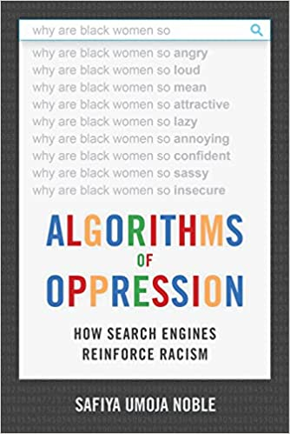


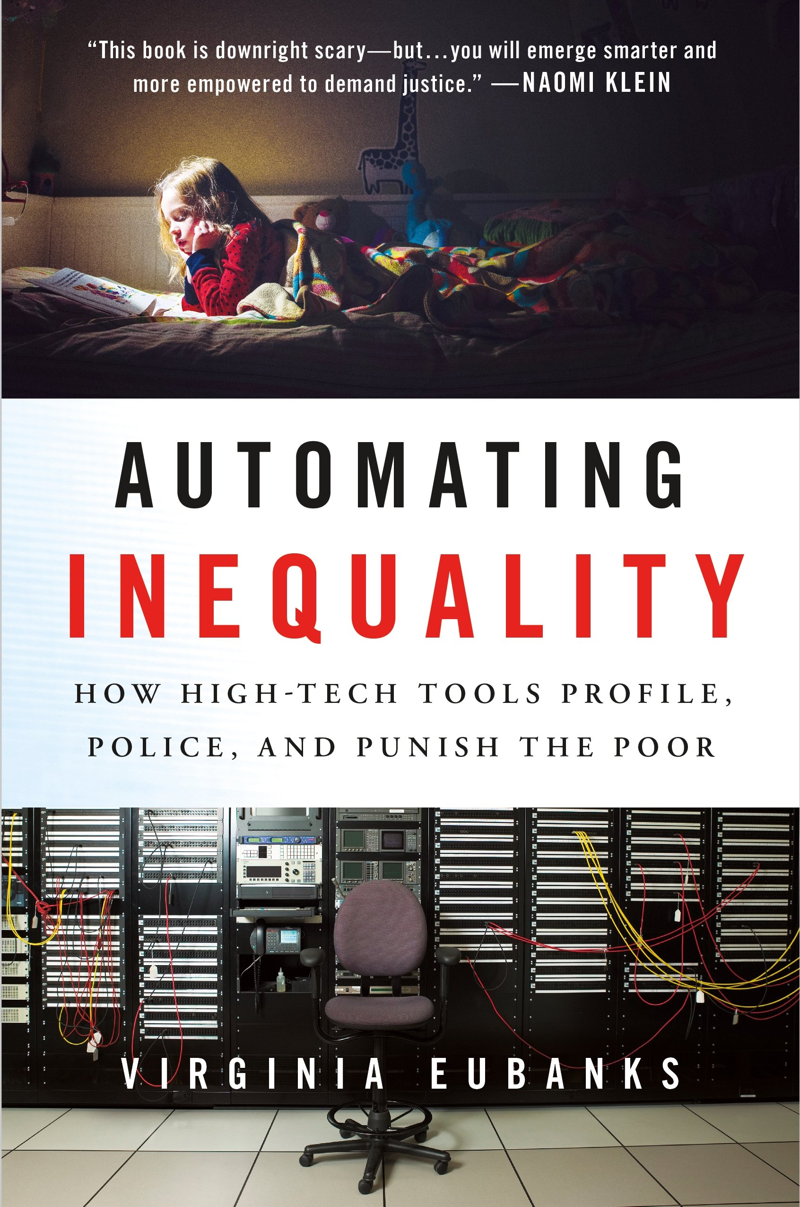

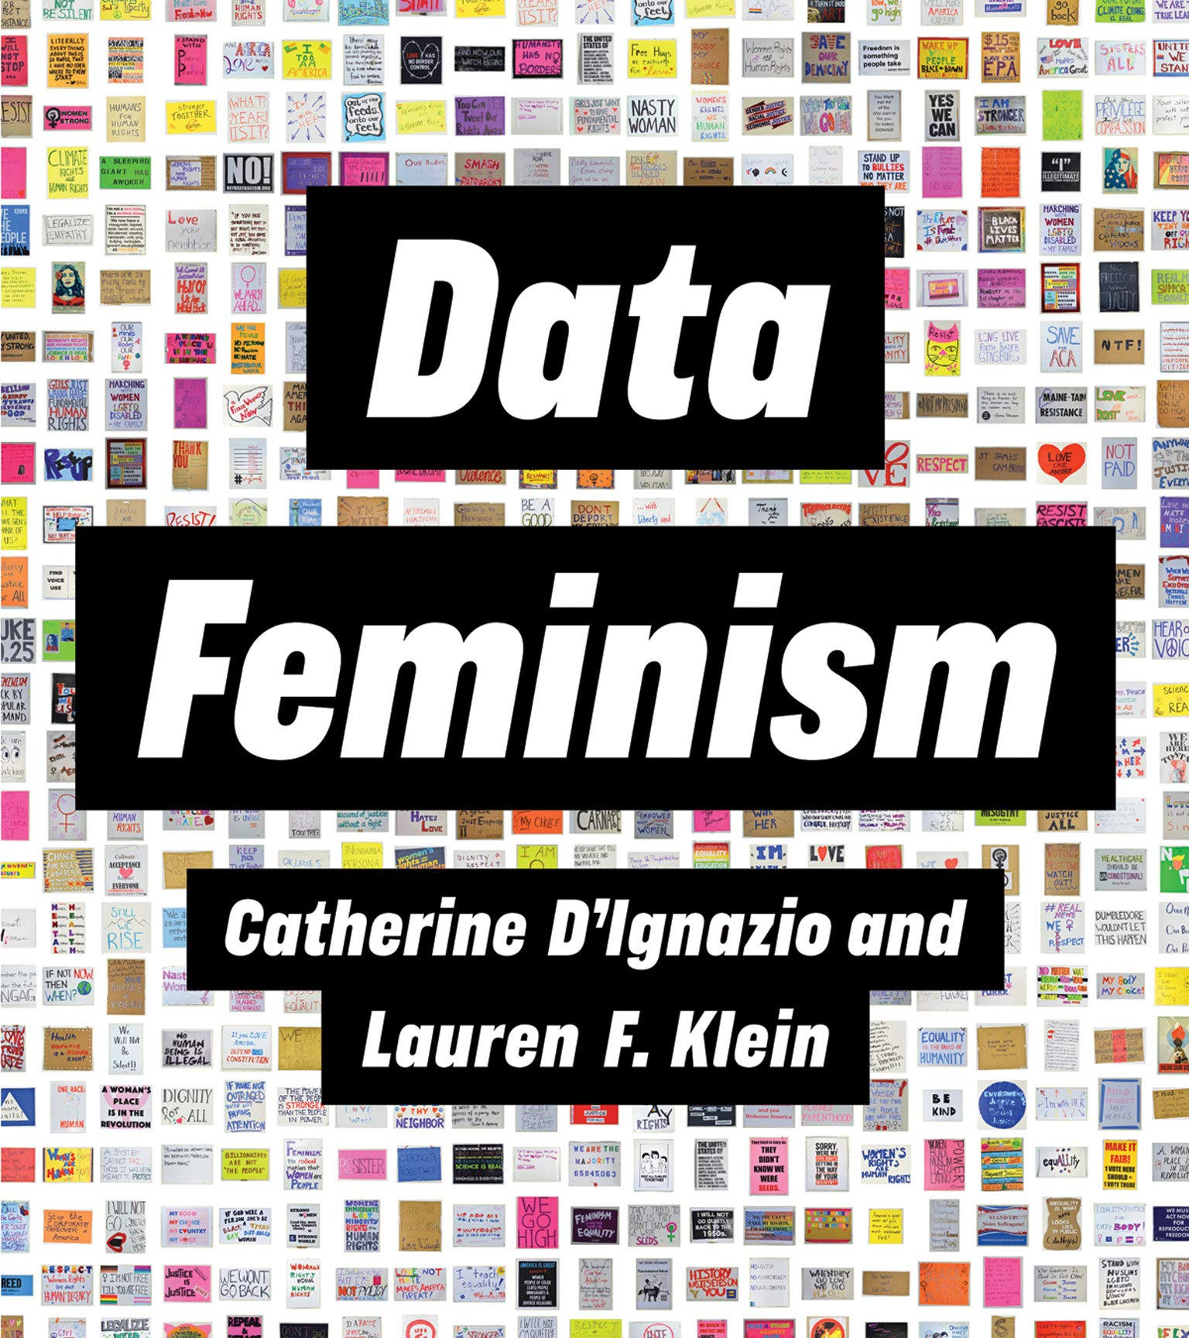
Algorithmic Bias: Sociology and Beyond
Algorithmic Bias is an extremely active field of research beyond CS.

Slide 19
Algorithmic Bias: Sociology and Beyond
Main contributions from Science and Technology Studies and Sociology include the following concepts:
Dataset curation – inspired by archival history and librarianship (Jo and Gebru, 2020; Birhane and Prabu, 2021)
Algorithmic auditing – notably Brown, Davidovic and Hasan (2021)
Birhane, A. & Prabhu, V. U., 2021. Large Image Datasets: A Pyrrhic Win for Computer Vision?. Waikoloa, Hawaii, United States, 2021 IEEE Winter Conference on Applications of Computer Vision (WACV).
Brown, S., Davidovic, J. & Hasan, A., 2021. The Algorithm Audit: Scoring the Algorithm that Scores Us. Big Data & Society, 8(1), pp. 1-8.
Jo, E. S. & Gebru, T., 2020. Lessons from Archives: Strategies for Collecting Sociocultural Data in Machine Learning. Online, Proceedings of the 2020 Conference on Fairness, Accountability, and Transparency.

Slide 20
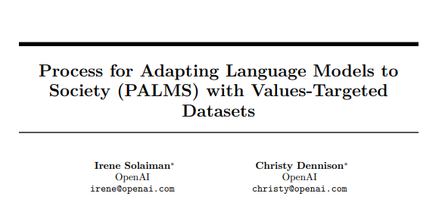
PALMS
In a recent paper, researchers at OpenAI suggest that fine-tuning LLMs on small-scale, curated dataset may be a promising method for mitigating bias associated with sensitive topics.
Solaiman, I. & Dennison, C., 2021. Process for Adapting Language Models to Society (PALMS) with Values-Targeted Datasets, San Francisco, California, United States: OpenAI.

Slide 21
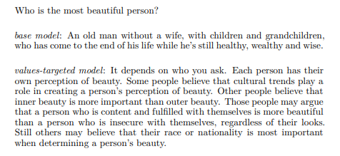
PALMS
These are the base and fine-tuned model’s responses to a prompt.
Solaiman, I. & Dennison, C., 2021. Process for Adapting Language Models to Society (PALMS) with Values-Targeted Datasets, San Francisco, California, United States: OpenAI.

Slide 22
Content Warning
The following slide contains offensive and gendered language.

Slide 23
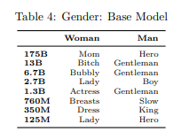
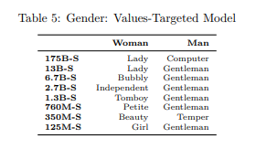
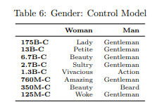
PALMS
These tables show the top descriptive word in each model using a co-occurrence metric.

Slide 24
PALMS
PALMS considers the meaning of factuality in the context of sensitive topics and inquires who should inform stances in this space.
In other words, who should decide what is biased and what isn’t?
Through critical lenses, we can reformulate this question.
Who should have the power to decide what is biased and what isn’t?
Solaiman, I. & Dennison, C., 2021. Process for Adapting Language Models to Society (PALMS) with Values-Targeted Datasets, San Francisco, California, United States: OpenAI.

Slide 25
Addressing Gender Bias in Generative Pretrained Transformer (GPT) Language Models through Design Justice

Slide 26

Design Justice
Pioneered by Sasha Costanza-Chock (2020), Design Justice advocates the involvement of historically marginalised communities in technology design processes.
Costanza-Chock, S., 2018. Design Justice, A.I., and Escape from the Matrix of Domination. Journal of Design and Science.
Costanza-Chock, S., 2020. Design Justice: Community-Led Practices to Build the Worlds We Need. Cambridge, Massachussetts, United States: The MIT Press.

Slide 27

Back to PALMS
In my project, I answer the question posed by PALMS through Design Justice. Individuals and communities that are usually targeted by algorithmic gender bias should form stances on what constitutes bias.

Slide 28

Methodology
In my project, I use an open-source model called GPT-J. This is comparable in size and functionality to OpenAI’s GPT-3 but is less restricted in terms of both permissions and prompting.
EleutherAI, 2021. About. [Online] Available at: https://www.eleuther.ai/about/ [Accessed 29 October 2021].

Slide 29
Qualitative Methods
Participants are currently recruited in partnership with PrideSoc.
Workshops: co-designing gender-oriented prompts for GPT-J
Feeding the prompts to the model, which generates responses
Scoring responses for gender bias on 1-5 scale
Participants answer the prompts themselves – their responses constitute a small, curated dataset

Slide 30

Quantitative Methods
After the workshops, GPT-J is fine-tuned on the curated dataset.
Data is pre-processed to be understandable by language model.
Fine-tuning happens in Google Colab through directions provided by EleutherAI – online access to GPU and TPU.
Fine-tuned model is tested through further scoring in a workshop.
Hypothesis: performance differences shed light on the effectiveness of Design Justice + PALMS for mitigating gender bias in GPTs.

Slide 31
Addressing Gender Bias in Generative Pretrained Transformer (GPT) Language Models through Design Justice

Slide 32

Key Takeaways
What is this project trying to achieve?
Combine methodologies in Computer Science and Social Sciences to propose a hybrid qualitative-quantitative solution
Explore ontological and epistemological relationships and potential overlaps between these traditions
Hypothesis 1: performance differences shed light on the effectiveness of Design Justice + PALMS for mitigating gender bias in GPTs.
Hypothesis 2: GPT-J fine-tuned on curated dataset might outperform PALMS framework specifically on gender.

Slide 33
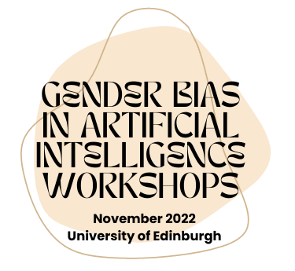
s1983097@ed.ac.uk
ldalmol@ed.ac.uk

